Slide 1
Output Primitives- DDA Algorithm
Nancy Victor
Assistant Professor
SITE, VIT University,
Vellore

Slide 2
Graphics Rendering Pipeline
Rendering is the conversion of a scene into an image.
3D Scene 2D Image

Slide 3
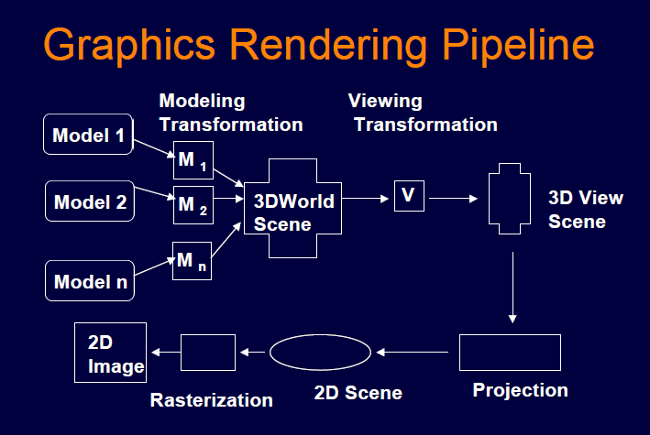

Slide 4
Rasterization (Scan Conversion)
Convert high-level geometry description to pixel colors in the frame buffer
Example: given vertex x,y coordinates determine pixel colors to draw line
Two ways to create an image:
  Scan existing photograph
  Procedurally compute values (rendering)

Slide 5
Rasterization
A fundamental computer graphics function
Determine the pixels’ colors, illuminations, textures, etc.
Implemented by graphics hardware
Rasterization algorithms
  Lines
  Circles
  Triangles
  Polygons

Slide 6
Rasterization Operations
Drawing lines on the screen
Manipulating pixel maps (pixmaps): copying, scaling, rotating, etc
Compositing images, defining and modifying regions
Drawing and filling polygons
Aliasing and antialiasing methods

Slide 7
Output Primitives
Output Primitives are basic geometric structures which describes a scene or a picture.
They are the building blocks of a picture.
  E.g.: point, line, curves, fillcolor etc..
Attributes:
  Properties of output primitives.
  An attribute describes how a particular primitive is to be displayed.
  E.g.: intensity, line styles, text styles etc..

Slide 8
Output Primitives
In order to draw the primitive objects, one has to first scan convert the object.
Scan convert refers to the operation of finding out the location of pixels to be intensified and then setting the values of corresponding bits, in the graphic memory, to the desired intensity code.
Each pixel on the display surface has a finite size depending on the screen resolution and hence a pixel cannot represent a single mathematical point.
A point is shown by illuminating a pixel on the screen.

Slide 9
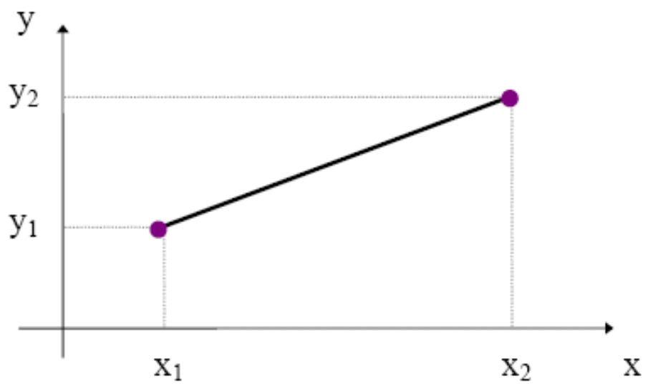
Line Drawing Algorithms
A line segment is completely defined in terms of its two endpoints.
A line segment is thus defined as:
    Line_Seg = { (x₁, y₁), (x₂, y₂) }

Slide 10
Line Drawing Algorithms
    A line is produced by means of illuminating a set of intermediary pixels between the two endpoints.
Lines are digitized into a set of discrete integer positions that approximate the actual line path.
Example: A computed line position of (10.48, 20.51) is converted to pixel position (10, 21).
    The rounding of coordinate values to integer causes all but horizonatal and vertical lines to be displayed with a stair step appearance “the jaggies”.

Slide 11
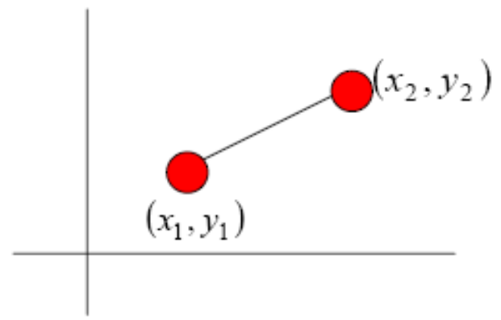
Line Drawing Algorithms
    Given Points (x₁, y₁) and (x₂, y₂)
Slope-intercept line equation
    y = mx + b
Slope, m = y₂ − y₁ / x₂ − x₁ = Δy / Δx
y-intercept b = y₁ − m.x₁
x-interval→Δx = Δy / m
y-interval→ Δy = m Δx

Slide 12
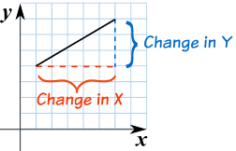
Line Drawing Algorithms
    Slope:
    The Slope (also called Gradient) of a straight line shows how steep a straight line is.
The method to calculate the slope is:
Divide the change in height by the change in horizontal distance
Slope = Change in Y /Change in X

Slide 13
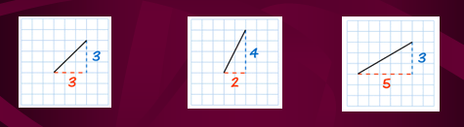
Line Drawing Algorithms
Slope=3/3=1
Slope=4/2=2
The line is steeper, and so the slope is larger
Slope=3/5=0.6
The line is less steep, and so the slope is smaller

Slide 14
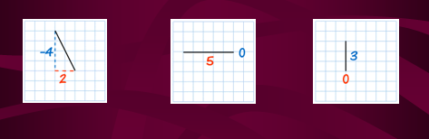
Line Drawing Algorithms
Slope: Positive or Negative???
Slope=-4/2=-2
That line goes down as you move along, so it has a negative slope.
Slope=0/5=0
A line that goes straight across has a slope of zero.
Slope=3/0
A "straight up and down" line's slope is "undefined".

Slide 15
Line Drawing Algorithms
The direction of a line is either increasing, decreasing, horizontal or vertical. A line is increasing if it goes up towards the right. The slope is positive, i.e. .
A line is decreasing if it goes down towards the right. The slope is negative, i.e. .
If a line is horizontal the slope is zero. This is a constant function.
If a line is vertical the slope is undefined

Slide 16
DDA Algorithm
Digital Differential Analyzer
Walk through the line, starting at (x0,y0)
Constrain x, y increments to values in [0,1] range
Case a: x is incrementing faster (m < 1)
  Step in x=1 increments, compute and round y
Case b: y is incrementing faster (m > 1)
  Step in y=1 increments, compute and round x
(x1,y1)
dy
(x0,y0)
dx

Slide 17
DDA Algorithm
A line algorithm Based on calculating either Δy or Δx using the above equations.
There are two cases:
  Positive slope
  Negative slope

Slide 18
DDA Algorithm (Positive Slope)
If m ≤ 1 then take Δx = 1
Compute successive y by
      y_{k+1} = y_{k} + m (1)
Subscript k takes integer values starting from 1, for the first point, and increases by 1 until the final end point is reached.
If m > 1, reverse the role of x and y and take Δy = 1, calculate successive x from
      x_{k+1} = x_{k} + 1/m (2)
In this case, each computed x value is rounded to the nearest integer pixel position.
The above equations are based on the assumption that lines are to be processed from left endpoint to right endpoint.

Slide 19
DDA Algorithm (Negative Slope)
In case the line is processed from Right endpoint to Left endpoint, then
    Δx = −1, y_{k+1} = y_{k} − m for m ≤ 1 (3)
    or
    Δy = −1, x_{k+1} = x_{k} −1/m for m > 1 (4)

Slide 20
DDA Algorithm
If m < 1,
  use(1) [provided line is calculated from left to right] and
  use(3) [provided line is calculated from right to left].
If m ≥ 1
  use (2) or (4).

Slide 21
Procedure lineDDA(xa,ya,xb,yb:integer);
Var
dx,dy,steps,k:integer
xIncrement,yIncrement,x,y:real;
begin
dx:=xb-xa;
dy:=yb-ya;
if abs(dx)>abs(dy) then steps:=abs(dx)
else steps:=abs(dy);
xIncrement:=dx/steps;
yIncrement:=dy/steps;
x:=xa;
y:=ya;
setPixel(round(x),round(y),1);
for k:=1 to steps do
begin
x:=x+xIncrement;
y:=y+yIncrement;
setPixel(round(x),round(y),1)
end
end; {lineDDA}

Slide 22
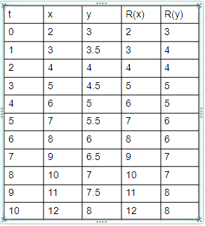
DDA Algorithm
Suppose we want to draw a line starting at pixel (2,3) and ending at pixel (12,8).
numsteps = 12 – 2 = 10
xinc = 10/10 = 1.0
yinc = 5/10 = 0.5

Slide 23
DDA Algorithm Drawbacks
DDA is the simplest line drawing algorithm
  Not very efficient
  Round operation is expensive
Optimized algorithms typically used.
  Integer DDA
  E.g.Bresenham algorithm
Bresenham algorithm
  Incremental algorithm: current value uses previous value
  Integers only: avoid floating point arithmetic

Slide 24
Thank You…

